Slide 1
Faculty Diversity & Work Life Survey Review
Diana L. Gray, M.D.
Associate Dean for Faculty Affairs
AWN - April 2017

Slide 2
Washington University School of Medicine Trends
 | 2001 (%) | 2006 (%) | 2011 (%) | 2016 (%)
Investigator Track Clinician Track Research Track | 840 (61) 348 (25) 198 (14) | 777(48) 566 (35) 274 (17) | 688 (37) 884 (47) 295 (16) | 661 (32) 1111 (53) 318 (15)
Total Faculty | 1386 | 1617 | 1867 | 2090
Women Women as % | 381 27% | 480 30% | 638 34% | 777 37%
Men Men as % | 1005 73% | 1137 70% | 1229 66% | 1313 63%
Underrepresented Minorities URM as % | 53 4% | 58 4% | 89 5% | 119 6%

Slide 3
Percentage of Women by Track at WUSM

Slide 4
Notes:
From Tammy Hershey

Slide 5
Figure 2. WUSM Faculty by Gender - 2016

Slide 6
WU 2015 Faculty Work Life Survey Medical Campus Results
Survey was conducted in late Fall of 2015; previous survey in Spring 2011.
All full time (100% FTE) WU academic personnel on Danforth and Medical campuses were surveyed, excluding only deans and top administrators.
Data compiled & analyzed by Lynn McCloskey & team, WU Institutional Research & Analysis

Slide 7
Response Rates Were High
 |  | 2011 Survey |  |  |  | 2015 Survey
 |  | Surveyed | Responded | Response Rate |  | Surveyed | Responded | Response Rate
Medical Campus Total |  | 1,737 | 999 | 58% |  | 1,918 | 1,298 | 68%
 | Investigator | 691 | 414 | 60% |  | 638 | 442 | 69%
 | Clinician | 767 | 413 | 54% |  | 980 | 631 | 64%
 | Research | 279 | 172 | 62% |  | 300 | 225 | 75%
 |  | Men 2015 |  |  |  | Women 2015
 |  | Surveyed | Responded | Response Rate |  | Surveyed | Responded | Response Rate
Medical Campus Total |  | 1,249 | 830 | 66% |  | 669 | 468 | 70%
 | Investigator | 183 | 143 | 78% |  | 117 | 82 | 70%
 | Clinician | 492 | 333 | 68% |  | 146 | 109 | 75%
 | Research | 574 | 354 | 62% |  | 406 | 277 | 68%

Slide 8
Overall satisfaction about the same as last survey No significant gender differences in 2015 for two key questions
Satisfaction being a faculty member at WU
mean response (scale 1-5) |  | 2011 | 2015 | change statistically significant? | 2015 gender dif statistically significant?
Investigator | Men | 4.2 | 4.1
 | Women | 4.1 | 4.2
Clinician* | Men | 4.2 | 4.0
 | Women | 4.1 | 4.0
Research | Men | 3.9 | 3.7
 | Women | 4.0 | 3.9
Satisfaction with work/life balance
Investigator | Men | 4.0 | 4.1
 | Women | 3.6* | 3.9
Clinician | Men | 3.8 | 3.7
 | Women | 3.6 | 3.6
Research | Men | 3.6 | 3.7
 | Women | 3.8 | 3.7
* Overall satisfaction rate fell for aggregate (men & women) from 4.2-> 4.0 (p<0.05)
* Difference was statistically significant (p<0.5)

Slide 9
Satisfaction with resources to support your work Resources for Teaching, for Research, for Clinical Work; Office space and Lab space (13 items)
How many resource items showed change in satisfaction from 2011 to 2015 (p < .05)?
 | higher in 2015 | lower in 2015 | no change
Investigator |  | 1 item: resources to support clinical work | 12 items
Clinician | 1 item: classroom space | 4 items: overall teaching resources; support for assessing & improv student learning; technical/research staff; Resources to support clinical work | 9 items
Research |  |  | 13 items
Few items showed change in satisfaction from 2011; none of the 13 items showed gender difference in 2015.
Notes:
13 tems include: satisfaction with classroom space, access to teaching assistants, support for innovation in your teaching, support for assessing and improving student learning, technology to support teaching, resources to support research and scholarship, start-up funds, support for securing grants, support for managing grants, technical/research staff, resources to support clinical work, office space, lab/research space.

Slide 10
Gender Difference Emerges in Items about Climate
Climate 2015: Items for which women more negative than men
 | Investigator | Clinician | Research
Satisfied with within-department collaboration | x
Feel excluded from informal network | x | x
Work harder to be perceived a scholar | x | x
Can balance personal/department obligations |  | x
Welcoming environment for women faculty | x | x
Welcoming environment for minority faculty | x | x
Experienced bias by leadership (% yes) | x | x | x
Experienced bias by colleagues (% yes) | x | x | x
Experienced bias by students (% yes) | x | x
WU sexual harassment policies/procedures - % appropriate and well communicated | x | x | x
WU racial bias policies/procedures - % appropriate and well communicated | x
X: Statistically significant differences between men and women p < .05

Slide 11
Wide gap between men and women for experience of bias
Survey question: In your professional career at WU, to what extent have you experienced bias or exclusion due to your gender, race or ethnicity, or other personal characteristic?
 | Investigator |  | Clinician |  | Research
2015 Survey | men | women | men | women | men | women
Experienced bias by leadership (% yes) | 13% | 62% | 13% | 51% | 19% | 55%
Experienced bias by colleagues (% yes) | 11% | 50% | 13% | 34% | 16% | 38%
Experienced bias by students (% yes) | 7% | 23% | 6% | 14% | Difference not statistically significant
p < .05.
More than half of women report bias by leadership
More than one third of women report bias by colleagues

Slide 12
Mentoring Question
While at Washington University, do you feel as though you have received adequate mentoring?
% yes, received adequate mentoring
 |  | 2011 | 2015 | Two signals of change noted but neither sig. at p < .05 | 2015 gender difference significant?
Investigator | Men | 72% | 67%
 | Women | 61% | 71% | improved | no
Clinician | Men | 55% | 58%
 | Women | 48% | 48% |  | yes
Research | Men | 56% | 69% | improved
 | Women | 61% | 63% |  | no
Only 48% of Clinician Track women said received adequate mentoring, same as in 2011.

Slide 13
Leadership: Investigator and Clinician Women are Willing to Serve
 |  | Investigator |  | Clinician |  | Research
 |  | Men | Women | Men | Women | Men | Women
% served in WU leadership role in last 5 years |  | 40% | 24%* | 27% | 26% | 4% | 9%
% never served in WU leadership role |  | 53% | 68%* | 70% | 74% | 95% | 91%
Q: In the past, how often have you been asked to serve in leadership positions such as department chair, director of a division, center or institute, or committee chair for a major academic or strategic planning initiative? (scale 1 = 'never' . . . 4 = 'frequently')
 | Investigator |  | Clinician |  | Research
 | Men | Women | Men | Women | Men | Women
 | 2.1 | 1.5* | 1.6 | 1.4* | 1.1 | 1.1
Q: How willing are you to assume leadership positions if asked to serve? (scale 1 = 'Very unwilling' . . . 5 = 'Very willing to serve')
 | 3.9 | 4.1 | 4.1 | 4.1 | 3.9 | 3.5*
Notes:
Red text with * indicates statistically significant difference between men & women for these questions in these categories (p < 0.5)

Slide 14
Lactation Support on Medical Campus
Have you experienced need for lactation rooms on campus?
Yes, personally needed or expect to need 34%
Yes, I know colleagues who need 48%
No, I don’t know of anyone with this need 18%
How satisfied are you with following?
Dissatisfied(%) Satisfied(%) Neutral(%)
Number of rooms available 32 51 18
Proximity to office or work space 34 51 15
Quality of space (comfort, privacy, furnishings) 26 52 22

Slide 15
What contributes most to the quality of your work life at WU? WUSM responses only – Clinician Track (n=631-64%)
13 pages of responses from one word to a paragraph, difficult to summarize
Most frequent responses
COLLEGIALITY
COLLABORATION & collaborative environment
EXCELLENCE of colleagues/staff/environment/institution
TEACHING opportunities
INTELLECTUAL stimulation
RESEARCH opportunities
MEANINGFUL work
LEADERSHIP quality & support

Slide 16
What contributes most to the quality of your work life at WU? WUSM responses only – Investigator Track (n = 442 – 69%)
9 pages of responses
Most frequent responses
COLLEGIATLITY
COLLABORATION & collaborative environment
EXCELLENCE of scholarship, environment, colleagues, staff, institution
RESEARCH opportunities
TEACHING opportunities
LEADERSHIP quality & support
INTELLECTUAL stimulation

Slide 17
What contributes most to the quality of your work life at WU? WUSM responses only – Research Track (n = 225 – 75%)
3+ pages of responses
Most frequent responses
EXCELLENCE of scholarship, environment, colleagues, staff, institution
COLLEGIATLITY
COLLABORATION & collaborative environment
RESEARCH opportunities
LEADERSHIP quality & support
INTELLECTUAL stimulation

Slide 18
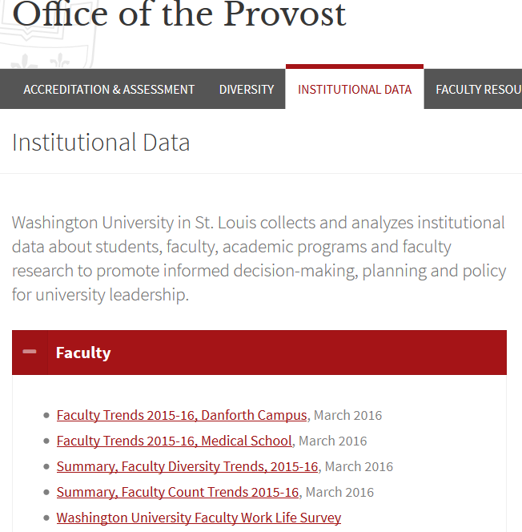
Faculty Survey Detail Reports are available here:
Analysis by Institutional Research & Analysis, Washington University

